Slide 1
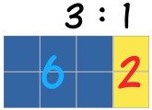
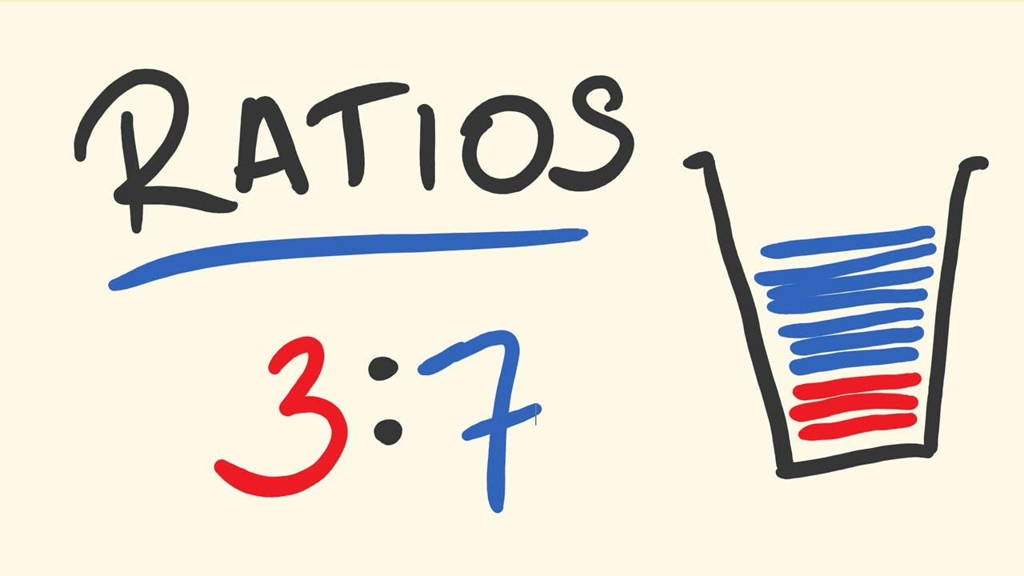
My Proportion Interactive Notebook
Name:
Class: 9-9
Teacher: Mr Evans
Term 2 Semester 1

Slide 2
A car travels 228 km in 3 hours.
(a) How long will it take to travel 912 km?
(b) How far will it travel in 7 hours?

Slide 3
Warm Up
Answer the following:
32 ÷ 8 =
56 ÷ 7 =
108 ÷ 12 =
99 ÷ 11 =

Slide 4
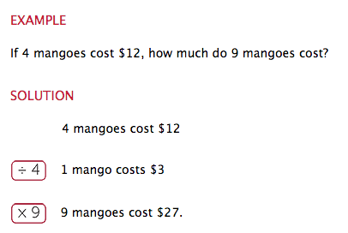
24
7
30
Date
Unitary Method
EQ – What is unitary method and when do we use it?
What is unitary method?
The unitary method is a technique which is used for solving a problem by finding the value of a single unit, i.e., 1, (by dividing) and then finding the necessary value by multiplication the single unit value.

Slide 5
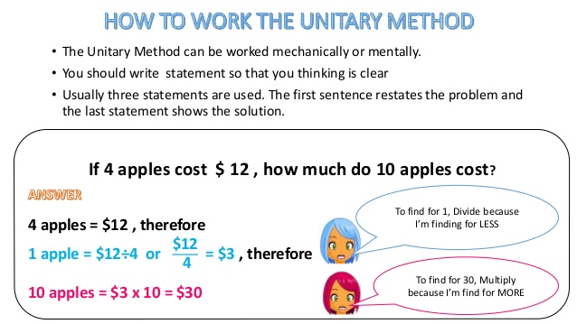
24
7
30
Date
Unitary Method
EQ – What is unitary method and when do we use it?
What is unitary method?

Slide 6


Let’s try some together.

Slide 7
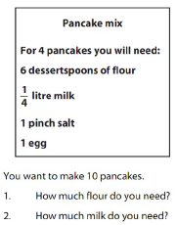
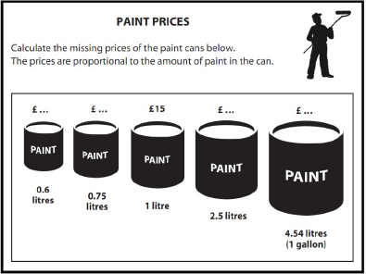
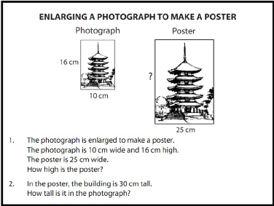
Complete the following on your own (use your notes if needed):
Now complete the Practice Exercise that has been handed out. Ensure it is glued into the Task Page of your interactive notebook.

Slide 8
Now, try this one again!!
A car travels 228 km in 3 hours.
(a) How long will it take to travel 912 km?
(b) How far will it travel in 7 hours?

Slide 9
Complete a 2 minute Quickwrite on what the Unitary Method is and how we use it.

Slide 10
Notes Review
24, 7 ,30
Date
Title
Essential question
Notes complete
Notes complete with colour and diagrams
Questions completed
Contents page filed in
Formula page filled in

Slide 11
Homework
Review your notes and write a summary answering the essential question.

